Slide 1


Unit-4 Financial Statements of Sole Proprietorship
Fundamentals of Accounting (FOA)
DU #2301MN523
Prof. Javed S. Nathani
javed.nathani@darshan.ac.in
91066 34874

Slide 2

Looping
Topics
Sole Proprietorship
Meaning of Sole Proprietorship
Meaning and Uses of Financial Statements
Elements of Financial Statements
Closing Adjustment Entries
Final Accounts
Practice Exercise
LLP
Private Limited Companies
Public Limited Companies

Slide 3
Meaning of Business Organisation
A business organisation is an establishment intended to carry commercial business by producing goods or services and meet the customers’ needs.
Main aim of the business organization is to generate profit from business operations.

Slide 4
Various Forms Of Business Organization
Forms Of Business Organization
Private Sector
Non-corporate Status
Corporate Status
Public Sector
Non-corporate Status
Sole Proprietorship
Partnership
Joint Hindu Family Business
Joint Stock Company
Co-operative Society
Corporate Status
Departmental Organization
Public Corporation
Government Company

Slide 5
Sole Proprietorship

Slide 6
Meaning of Sole Proprietorship
This is the traditional and popular form of business organisation.
Its formation is simple, and the owners controls the complete operations of a business and is liable for all financial burdens and debts.
As long as they are the only owner, they have the right to operate any category of business.
All the decisions related with business are taken by sole proprietor.
For Example:
Shop or Retail business, Home-based company, Individual consulting firm, etc.

Slide 7
Meaning of Final Accounts
Final Accounts is the ultimate stage of the accounting process
where the different ledger maintained in the trial balance (Books of Accounts) of the business organization are presented in the specified way
to provide the profitability and financial position of the entity for a specified period to the stakeholders and other interested parties,
i.e., Trading Account, Profit & Loss Account and Balance Sheet.
Final Accounts means accounts which are prepared at the final stage to give the financial position of the business.
The determination of the Profit or Loss is done by preparing a Trading and Profit & Loss Accounts.
While the financial position is judged by means of preparing a Balance Sheet of the business.

Slide 8
Financial Statement

Slide 9
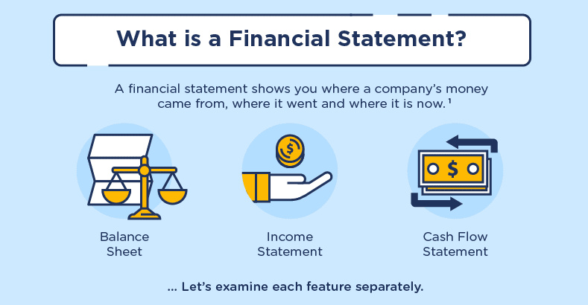
Meaning of Financial Statement (FS) (નાણાકીય પત્રક)
Financial statement means the basic and formal annual reports through which the corporate management communicates financial information.
Financial statements shows you where a company’s money came from, where it went and where it is now.
Financial statement is a structured representation of the financial position (Balance Sheet), financial performance (Income Statement) of an entity and the inflow and outflow of cash (Cash flow statement).

Slide 10
Uses of Financial Statements
Determine the financial position of the business
To obtain credit
Helps investors in decision making
Helps in policy making
Useful for stock traders

Slide 11
Objectives of Financial Statement Analysis
Analysis of past performance
Analysis of Current Financial Position
Analysis of Operating Efficiency
Analysis of Risk
Projections of Future Performance
Investment Decisions
Lending Decisions
Prediction of Bankruptcy (નાદારી)

Slide 12
Elements of Financial Statements

Slide 13
Elements of Financial Statements
Elements of Financial Statements
Relating to Measurement of Financial Position
Asset
Liability
Relating to Measurement of Profit
Income
Equity
Expenses

Slide 14
Elements of Financial Statements : Asset
The term “Assets” denotes the resources acquired by the business from the funds made available either by the owners of the business or others.
An enterprise usually employs its assets to produce goods or services capable of satisfying the wants or needs of customers.
Since these goods or services can satisfy wants or needs, the customers are prepared to pay for them and hence contribute to the cash flow of the enterprise.
Many assets have a physical form.
For Example: land and building, plant, equipment etc. are of physical form.
However, physical form is not necessary for the existence of an asset.
For Example: patent, goodwill, copyright, etc.

Slide 15
Classification of Assets
Current Assets
Current assets are those assets which are acquired with the intention of converting them into cash during the normal business operation of the enterprise.
For Example: debtors, stock, bills receivable, etc.
Liquid Assets
Liquid assets are those assets which are immediately converted into cash without much loss.
Fixed Assets
Fixed assets are those assets which are acquired for relatively long period for carrying on the business of the enterprise.

Slide 16
Classification of Assets
Intangible Assets
Intangible assets are those assets which cannot be seen and touched.
For Example: goodwill, patent, trademark, etc.
Fictitious Assets
There are assets not represented by tangible possession or property.
For Example: promotional expense, Preliminary expense, discount on issue of shares, etc.

Slide 17
Elements of Financial Statements : Liability
Liabilities are claim of the creditors against the enterprise arising out of past activities that are to be satisfied by the disbursement or utilization of corporate resources.
Liabilities result from past transactions or other past events.
Some liabilities can be measured only by using a substantial degree of estimation.

Slide 18
Classification of Liabilities
Current Liabilities
The term “Current Liabilities” is used for such liabilities which are payable within a particular accounting period.
For Example: bills payable, outstanding expenses, bank overdraft, etc.
Fixed Liabilities
All liabilities other than Current Liabilities come within this category.
In other words, these are the liabilities which do not become due for payment in one year and which do not require current assets for their payment.

Slide 19
Elements of Financial Statements : Equity
Equity is a residual interest in the assets of the enterprise after deducting its liabilities.
The equity meaning in accounting refers to a company’s book value, which is the difference between liabilities and assets on the balance sheet.
Equity = Assets - Liabilities
In a corporate enterprise equity is suitable sub-classified in the balance sheet.
For Example: in India equity is classified as Share Capital and Reserve and Surplus.

Slide 20
Elements of Financial Statements : Income
Income is increase in economic benefits during the accounting period in the form of inflows or enhancement of assets or decreases of liabilities that result in increase in equity, other than those relating to contribution from equity participation.
The definition of income encompasses both revenue and gains.
Income may also result from settlement of liabilities.
Revenue arises in the course of the ordinary activities of an enterprise and is rendered by a variety of different names, including fees, interest, dividends and rent.
Gain is a general increase in the value of an asset or property.

Slide 21
Elements of Financial Statements : Expenses
Expenses are decreases in economic benefits during the accounting period in the form of outflows or depletions of assets or incurrences in liabilities that result in decreases in equities other than those relating to distribution to equity participants.
For Example: cost of sales, wages, manufacturing expenses, depreciation.
They usually take the form of an outflow or depletion of an asset such as cash and cash equivalent, inventory, property, plant and equipment.
Losses represents other items that meet the definition of expenses and may or may not arising in the course of the ordinary activities of the enterprise.
For Example: loss due to fire, loss due to flood, etc.

Slide 22
Closing Adjustment Entries

Slide 23
Closing Adjustment Entries
Treatment of items of adjustment appearing outside and inside in the Trial Balance.
If any item of adjustment appears outside the Trial Balance, it will be shown at two appropriate places in the final accounts.
If any item of adjustments appears inside the Trial Balance, it will be shown only at one appropriate place in the final accounts.

Slide 24
Adjustment | If given in Trial Balance | If not given in Trial Balance
1. Closing stock | Balance Sheet – Asset Side | Trading A/c – Credit Side Balance Sheet – Asset Side
2. Outstanding Expenses | Balance Sheet – Liability Side | Trading/Profit & Loss A/c Debit Side. Balance Sheet – Liability Side
3. Prepaid Expenses | Balance Sheet – Asset Side | Trading/Profit & Loss A/c Debit Side. Deduct from the concerned expenses. Balance Sheet - Asset Side.
4. Income Outstanding | Balance Sheet – Asset Side | Profit & Loss A/c – Credit Side. Add to the concerned income. Balance Sheet – Asset Side.
5. Incomes Received in Advance | Balance Sheet – Liability Side | Profit & Loss A/c – Credit Side. Deduct from concerned income. (b) Balance Sheet – Liability Side
6. Bad Debts | Profit & Loss A/c – Debit Side | Profit & Loss A/c – Debit Side. Balance Sheet – Asset Side. Deduct from debtors.

Slide 25
Adjustment | If given in Trial Balance | If not given in Trial Balance
7. Provision for Bad or Doubtful debts | Profit & Loss A/c – Debit Side | Profit & Loss A/c – Debit Side. Balance Sheet – Asset Side. Deduct from debtors after addition bad debts, if any.
8. Provision for Discount on Debtors | Balance Sheet – Asset Side Deduct from Debtors. | Profit & Loss A/c – Debit Side. Balance Sheet – Asset Side. Deduct from debtors after providing for provision for bad debts
9. Depreciation | Profit & Loss A/c – Debit Side | Profit & Loss A/c – Debit Side. Balance Sheet – Asset Side. Deduct from Respective Asset.
10. Interest on Capital | Profit & Loss A/c – Debit Side | Profit & Loss A/c – Debit Side. Balance Sheet – Liability Side. Add to Capital.

Slide 26
Adjustment | If given in Trial Balance | If not given in Trial Balance
11. Interest on Drawings | Profit & Loss A/c – Credit Side | Profit & Loss A/c – Credit Side. Balance Sheet – Liability Side. Deduct from Capital.
12. Loss by Fire | Profit & Loss A/c – Debit Side | Trading A/c – Credit Side (with full amount of loss) Profit & Loss A/c – Debit Side (Actual loss, if any). (c) Balance Sheet – Asset Side (with insurance claim admitted by Insurance Co.)
13. Goods withdrawn for personal use | Trading A/c - Credit Side | (a) Trading A/c – Credit Side or Deduct from purchases. (b) Balance Sheet – Liability Side (Deduct from Capital as Drawings)

Slide 27
Adjustment | If given in Trial Balance | If not given in Trial Balance
14. Goods Distributed as free samples | Profit & Loss A/c – Debit Side | Trading A/c – Credit Side or Deduct from Purchases Profit & Loss A/c – Debit Side
15. Sale of Goods on Approval Basis, approval not yet received | Usually it is not given in Trial Balance | Trading A/c – Credit Side. Deduct from Sales the selling price of goods sold and add to stock at cost price. Balance Sheet – Asset Side. Deduct from Debtors the selling price of such sales and show the cost price of such sales along with closing stock.

Slide 28
Financial Statement/Final Accounts
Financial Statements
Income Statements
Position Statements
Trading Account
Profit & Loss Account
Gross Profit or Gross Loss
Net Profit or Net Loss
Balance Sheet
Position of Assets & Liabilities

Slide 29
Trading Account
Trading account is one of the financial statements which shows the result of buying and selling of goods and/or services during an accounting period.
Trading account is prepared to know the gross profit or gross loss during the accounting period.
At the end of the year, it is necessary to ascertain the net profit or the net loss.
For this purpose, it is first necessary to know the gross profit or gross loss.
Gross Profit is the difference between the selling price and the cost of the goods sold.

Slide 30
Trading Account
For a trading firm, the cost of goods sold can be ascertained by adjusting the cost of goods still on hand at the end of the year against the purchases. It is done as follow:
Cost of Goods Sold = Net Purchases – Closing Stock
Closing Stock = Opening Stock + Purchases (Net) + Direct Expenses – Cost of Goods Sold
Gross Profit = Net Sales – Cost of Goods Sold

Slide 31
Dr. Trading Account of……for the year ended…… Cr.
Particulars | ₹ | ₹ | Particulars | ₹ | ₹
To Opening Stock To Purchases Less: Returns outwards To Direct expenses: Freight & Carriage Customs & Insurance Wages Gas, Water & Fuel Factory Expenses Royalty on production To Gross Profit c/d* (Transferred to P&L A/c) | XXX XXX XXX XXX XXX XXX XXX XXX | XXX XXX XXX XXX XXX XXX XXX | By Sales Less: Returns Inwards By Closing Stock By Gross Loss c/d* (Transferred to P&L A/c) | XXX XXX | XXX XXX XXX XXX

Slide 32
Profit and Loss Account
The Profit and Loss Account starts with gross profit on the credit side.
If there is gross loss, it will be written on the debit side.
After that all those expenses and losses, which have not been entered in the Trading Account, will be written on the debit side of Profit and Loss Account.
Incomes and gains, other than sales, will be written on the credit side.
Further, it may be noted that the expenses which are personal in nature will not be charged to Profit and Loss A/c. Only those revenue expenses and losses which are related to the current year, are debited to Profit and Loss Account.
Profit and Loss Account should be prepared in such a manner as will enable the reader to form a correct idea about the profit earned or loss suffered by the firm.
All other expenses like Administrative expenses, Selling and Distribution expenses and Finance related expenses are recorded in Profit & Loss account.

Slide 33
Dr. Profit and Loss Account of……for the year ended…… Cr.
Particulars | ₹ | ₹ | Particulars | ₹ | ₹
To Gross Loss b/d* Management expenses To Salaries (administrative) To Office rent, rates and Taxes To Printing and stationery To Telephone charges To Postage and telegrams To Insurance To Audit Fees To Legal Charges To Electricity Charges | XXX XXX XXX XXX XXX XXX XXX XXX XXX | XXX XXX | By Gross Profit b/d* Other Income By Discount Received By Commission Received Non-Trading Income By Bank Interest By Rent of property let-out By Dividend from shares Abnormal Gains By Profit on sale of machinery By Profit on sale of investment By Net Loss (Transferred to Capital A/c) | XXX XXX XXX XXX XXX XXX XXX XXX | XXX XXX XXX XXX

Slide 34
Dr. Profit and Loss Account of……for the year ended…… Cr.
Particulars | ₹ | ₹ | Particulars | ₹ | ₹
Maintenance expenses To Repairs & renewals To Depreciation on: Office Equipment Office Furniture Office Buildings Selling and Distribution expenses To Salaries (selling staff) To Advertisement To Godown rent To Carriage Outward To Bad Debts To Provision for bad debts To Selling commission | XXX XXX XXX XXX XXX XXX XXX XXX XXX XXX XXX | XXX XXX

Slide 35
Dr. Profit and Loss Account of……for the year ended…… Cr.
Particulars | ₹ | ₹ | Particulars | ₹ | ₹
Financial expenses To Bank charges To Interest on loans To Discount on bills To discount allowed to customers Abnormal Losses To Loss on sale of machinery To Loss on sale of investment To Loss by fire To Net Profit (Transferred to Capital A/c) | XXX XXX XXX XXX XXX XXX XXX | XXX XXX XXX |  |  | XXX

Slide 36
Balance Sheet
The balance sheet may be defined as “a statement which sets out the assets and liabilities of a firm or an institution as at a certain date.”
It is called a Balance Sheet because it is a sheet of balances of those ledger accounts
which have not been closed till the preparation of the Trading and Profit and Loss Account.
Since even a single transaction will make a difference to some of the assets or liabilities, the balance sheet is true only at a particular point of time.
That is the significance of the word “as at.”
The assets are shown on the right hand side and liabilities and capital on the left hand side.

Slide 37
Characteristics of Balance Sheet
It is prepared at a particular date, rather the close of a day and not for a period. It is true only on that date and not later.
The balance sheet is prepared only after the preparation of the Profit and Loss Account.
This is the reason why the Profit and Loss Account (including the Trading Account) and the Balance Sheet are together called Final Accounts.
A Balance Sheet is only a statement and not an account. It has no debit side or credit side. The headings of the two sides are ‘Assets’ and ‘Liabilities’.
Capital always equals the difference between assets and liabilities.
The two sides of the Balance Sheet must have the same totals.
If it is not so, there is certainly an error somewhere.

Slide 38
Balance Sheet of……as on……
Liabilities | ₹ | ₹ | Assets | ₹ | ₹
Capital A/c: Balance Add: Net Profit/Less: Net Loss Less: Drawings Long Term Loans : Term Loans Other Loans Short Term Loans : Cash Credit Bank Overdrafts Other Loans | XXX XXX XXX XXX XXX XXX XXX | XXX XXX | Tangible Fixed Assets : Land and Building Plant and Machinery Furniture and Fixture Vehicles Intangibles Fixed Assets : Goodwill Patent Rights Trademark Copyright Investments : Long term investments | XXX XXX XXX XXX XXX XXX XXX XXX | XXX XXX XXX

Slide 39
Balance Sheet of……as on……
Liabilities | ₹ | ₹ | Assets | ₹ | ₹
Current Liabilities : Trade Payables Outstanding Expenses Advance Taken Provision : Provision for Bad debts Provision for Retirement Benefits Provision for Taxation | XXX XXX XXX XXX XXX XXX | XXX XXX XXX | Current Assets : Inventory in Trade Trade receivables Short term investments Prepayments Advances Bank Balance Cash In Hand | XXX XXX XXX XXX XXX XXX XXX | XXX XXX

Slide 40
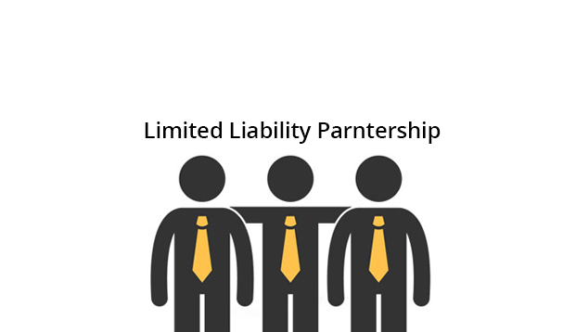
Limited Liability Partnership (LLP)

Slide 41
Concept of LLP
A limited liability partnership (LLP) is a flexible legal and tax entity where every partner has a limited personal liability for the debts or claims of the partnership.
A limited liability partnership (LLP) is a partnership in which some or all partners (depending on the jurisdiction) have limited liabilities. It therefore can exhibit aspects of both partnerships and corporations.
In an LLP, each partner is not responsible or liable for another partner's misconduct or negligence.
Unlike corporate shareholders, the partners have the power to manage the business directly.
LLP is an alternative corporate business form that gives the benefits of limited liability of a company and the flexibility of a partnership.
The LLP can continue its existence irrespective of changes in partners. It is capable of entering into contracts and holding property in its own name.
Since LLP contains elements of both ‘a corporate structure’ as well as ‘a partnership firm structure’ LLP is called a hybrid between a company and a partnership.

Slide 42
Features of LLP
Liability of Partners - The liability of Partners is limited to their contribution of share in the business. A partner is liable for his own wrongful acts. One Partner is not responsible for the acts of others due to negligence or misconduct.
Legal entity - LLP is a body incorporated and a legal entity separate from its partners having perpetual succession as per Section 3 of the Limited Liability Partnership Act, 2008.
Limit of Partners - A minimum of two partners are required to form an LLP as per Section 6(1) of the Limited Liability Partnership Act, 2008. There is no maximum limit on the number of partners.
Audit of Accounts - LLP shall maintain annual accounts where audit of the accounts is required only if the contribution exceeds Rs. 25 lakh or annual turnover exceeds Rs. 40 lakh.
Admission or Retirement of Partner - LLP can continue its existence irrespective of changes in partners.
Designated Partners - LLP shall have two individuals as designated partners and one of them shall be resident of India.

Slide 43
Process of Registration of LLP
Apply for DIN
Incorporation of LLP
01
02
03
04
05
Obtain DSC
File LLP Agreement
Name Approval

Slide 44
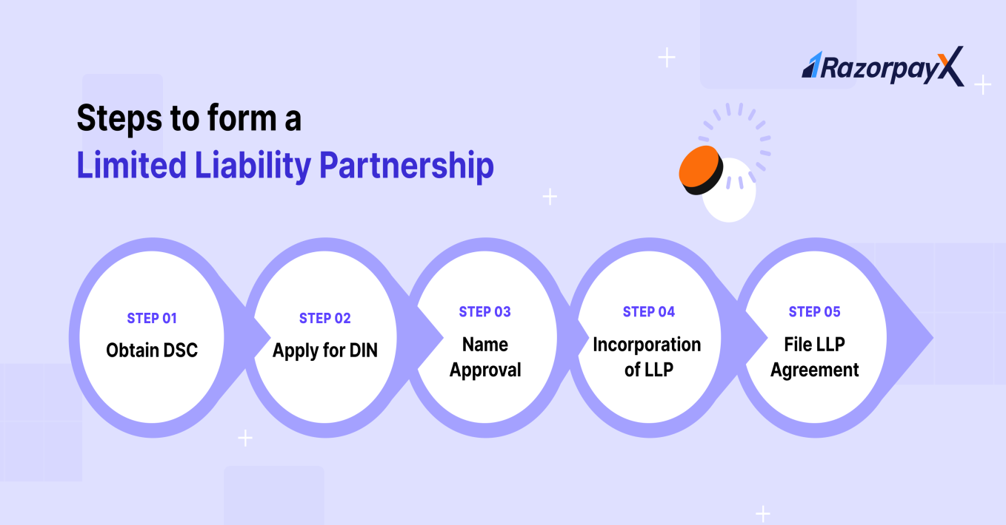
Process of Registration of LLP
Obtain Digital Signature Certificate (DSC)
Apply for Director Identification Number (DIN)
Name Approval
Incorporation of LLP
File LLP Agreement

Slide 45
Benefits of LLP
An LLP functions as a distinct legal entity, similar to a company. It can enter into contracts and legal proceedings in its name.
An LLP also gives the benefit of perpetual succession – this means that the partnership continues to exist even if a partner drops out of the business.
Partners can add new partners who can bring more expertise or resources to the business.
Limited Liability Partnerships are ideal forms of business for professionals who want to start their own practice. For example, many law firms choose to register as LLPs.
Partners enjoy limited liability, restricting their financial exposure to their contributed capital. In insolvency cases, only LLP assets are used to settle debts, shielding partners from personal financial obligations. It protects the personal liability of its founders in case of litigation and losses.
Forming an LLP is cost-effective compared to public or private limited companies. You only need to file two statements annually: the Annual Return and the Statement of Accounts and Solvency for the compliance requirements.
LLP formation doesn't demand a minimum capital contribution, offering flexibility to partners.

Slide 46
Private Limited Companies and Public Limited Companies

Slide 47
Private Limited Companies
A private limited company, also known as Pvt Ltd company, is an organization that limits the owners' liability and restricts the ability to transfer its shares.
The maximum number of shareholders is 50. A private limited company is registered under the Companies Act 2013.
Private limited companies are popular among small and medium-sized businesses (SMEs) due to their flexibility, limited liability protection, and simplicity of ownership control.
Private limited companies have an advantage over public companies in terms of long-term investment, keeping data confidential, operational independence, and flexibility.

Slide 48
Features of Private Limited Companies
Membership
Like any other company, a minimum of 2 shareholders are required to start such a company. But since it remains a small entity, there is also a maximum cap on the number of members fixed at 200.
Limited Liability Structure
In a private limited company, the liability of each member or shareholder is limited. Therefore, even in the case of loss under any circumstances, the shareholders are liable to sell their assets for repayment. However, the personal and individual assets of the shareholders are not at risk.
Separate Legal Entity
This is a separate legal entity and continues in perpetual succession. This means that even if all the members die, or the company becomes insolvent or bankrupt, the company still exists in the eyes of the law. The life of the company will be perpetual, not affected by the lives of its shareholders or members unless dissolved by way of resolution.
Minimum Paid-Up Capital
A private limited company is required to have and maintain a minimum paid-up capital of ₹1 lakh.

Slide 49
Types of Private Limited Companies
Company limited by shares
A company limited by shares is a legal entity independent of its directors and shareholders. It can make contracts as an organization and own assets in its name since it is a legal entity that can exist independently.
The word ‘limited’ relates to the shareholders' limited obligation. They are solely liable for any company responsibilities according to the value of their shares in that firm. No personal assets are at risk.
Company limited by guarantee
A company limited by guarantee has no shareholders or share capital. It is backed by guarantors who agree to pay a fixed amount towards the company's debts if required.
Profits are typically not distributed to guarantors since they are reinvested in the firm to assist and promote the company's non-profit aims.
Unlimited company
Section 2(92) of the Companies Act of 2013 defines an unlimited company as one with unlimited shareholders' liability.
Unlimited companies have no restrictions on their liabilities. As a result, the company can utilize all of its assets to pay down its obligations while dissolving.

Slide 50
Public Limited Companies
The Companies Act, 2013 regulates the establishment and working of a public limited company.
A public limited company offers shares to the general public and has limited liability.
Its stock can be acquired by anyone, either privately through Initial Public Offering (IPO) or via trades on the stock market.
It is strictly regulated and is required to publish its true financial health to its shareholders.
Public Limited Company is governed by the Companies Act of 2013, which defines it as a company which is not a “private company”, “has a minimum amount of capital as prescribed” and “has a minimum of seven shareholders”.
Few examples of Public Limited Company are:
Indian Oil Corporation Ltd, Bharat Petroleum Corporation Ltd, State Bank of India, Hindustan Petroleum Corporation Ltd, Oil and Natural Gas Corporation Ltd

Slide 51
Features of Public Limited Companies
Separate legal entity: This is a separate legal entity and continues in perpetual succession. This means that even if all the members die, or the company becomes insolvent or bankrupt, the company still exists in the eyes of the law.
Easy Transferability: Shares of public limited companies can be easily transferred by one member to other members.
Name: In the Public limited company, they add (Ltd.) at the end of the name of a company.
Number of members There must be 7 members in a Public company, there is no upper or lower limit to this number.
Prospectus: A prospectus can be issued to invite the public to subscribe to its shares by registering a public limited company. A prospectus is a statement that contains detailed information about the company as well as the number of shares requested by the company for an IPO or subsequent listing.

Slide 52
Features of Public Limited Companies
Borrowing capacity: Public companies have the advantage of being able to borrow money from many sources. Public companies can issue debts (secured and unsecured) to raise money. It can also issue preference or equity shares to the public. The company can receive financial aid and loans from banks and other financial institutions.
Voluntary Association: It’s easy to purchase shares in a public company, and it’s just as easy to leave the public company.
Certificate of Commencement: This is a vital document that must be obtained by the public company before starting a business. The Certificate of Incorporation is the last document needed for a private company. But, for public companies, both the Certificate of Incorporation and Certificate of Commencement is required.
Memorandum of Association: The MOA, which is an important document for the formation of a public company, is essential. After completing the Articles of Association, a private company can begin its business. But, for a public company, the Memorandum must be submitted along with the company’s registration.

Slide 53
Types of Public Limited Companies
Listed Company
This type of public limited company has its shares actively listed and available for trading on one or more stock exchanges. This accessibility allows the public and various financial entities to buy and sell the company's shares, providing greater liquidity and exposure to a diverse pool of investors.
Unlisted Company
Unlike its listed counterparts, an unlisted public limited company does not have its shares traded on any stock exchange. As a result, its shares are not as easily transferable, and the company does not experience the same level of public scrutiny or regulatory requirements as a listed company. This category of public limited company may appeal to businesses seeking to benefit from a broader base of shareholders while avoiding the complexities of full public trading.

Slide 54
Private Limited Companies VS Public Limited Companies
 | Private Limited Company | Public Limited Company
Ownership | A private limited company is privately held and owned by a small group of individuals or entities. The number of shareholders is limited, often to a maximum of 50. Shares of a private company are not traded on the stock exchange. | A public company, on the other hand, is owned by a large number of shareholders and the shares are freely traded on the stock exchange. There is no limit to the number of shareholders in a public company.
Share Transferability | In a private limited company, the transfer of shares is usually restricted and requires the approval of existing shareholders. This restriction helps maintain control over ownership and decision-making. | Shares of a public company can be freely bought and sold on the stock exchange without the need for approval from other shareholders. This liquidity makes it easier for investors to enter or exit their positions

Slide 55
Private Limited Companies VS Public Limited Companies
 | Private Limited Company | Public Limited Company
Capital Raising | Private companies typically raise capital through contributions from a small group of investors, loans, or retained earnings. They cannot raise capital by issuing shares to the public. | Public companies can raise capital by issuing shares to the public through an initial public offering (IPO) and subsequent offerings on the stock market. This allows them to access a larger pool of investors and raise substantial funds for expansion
Regulatory Compliance | Private companies usually have less stringent regulatory requirements compared to public companies. The reporting and disclosure obligations are generally limited, and they are not required to publish their financial statements for public scrutiny. | Public companies are subject to more extensive regulatory requirements. They must adhere to strict reporting standards, disclose financial information regularly, and comply with regulations set by the securities exchange where their shares are listed

Slide 56
Private Limited Companies VS Public Limited Companies
 | Private Limited Company | Public Limited Company
Minimum Capital Requirements | There is often no minimum capital requirement for private limited companies, and they can be formed with a relatively small amount of capital | In some jurisdictions, there may be minimum capital requirements for public companies, especially at the time of their initial public offering (IPO)

Slide 57
LLP VS Company
 | LLP | Company
Definition | A Limited Liability Partnership is a hybrid combination having features similar to a partnership firm and liabilities similar to a company. | Registered type of entity with limited liability to the owners and shareholders.
Ownership | Designated Partners | Min 2 Directors Min 2 Shareholders
Liability | Limited | Limited
Documentation | LLP Deed Incorporation Certificate | MOA AOA Incorporation Certificate
Governance | LLP Act, 2008 | Companies Act, 2013

